Slide 1
Project 2 EXPLANTORY DATA ANALYSIS
OGTIP - Oeson Global Training & Internship Program
HUMAN RESOURCE DATASET
Presented by : ADAN ABDULLAHI

Slide 2
PROJECT DESCRIPTION
Conduct an in-depth analysis of an HR (Human Resources) Dataset, containing employee details such as ID, Job Title, Performance Ratings, Salaries, and more.
Utilize the powerful data visualization capabilities of matplotlib and seaborn libraries to create meaningful charts and graphs. These visual representations will help unearth underlying patterns and trends within the data.
Uncover insights related to top-performing employees and exceptional managers. Use this knowledge to develop innovative models that can serve as a valuable tool for assessing employee performance within the XYZ Technologies organization.
Produce a comprehensive report summarizing the findings and insights gleaned from these visualizations. This report will provide a clearer understanding of the dynamics within the company's workforce.
Conclude the analysis with well-founded recommendations and suggestions for potential enhancements to the company's incentive programs. This will pave the way for the organization to further improve its operations and foster employee growth.

Slide 3
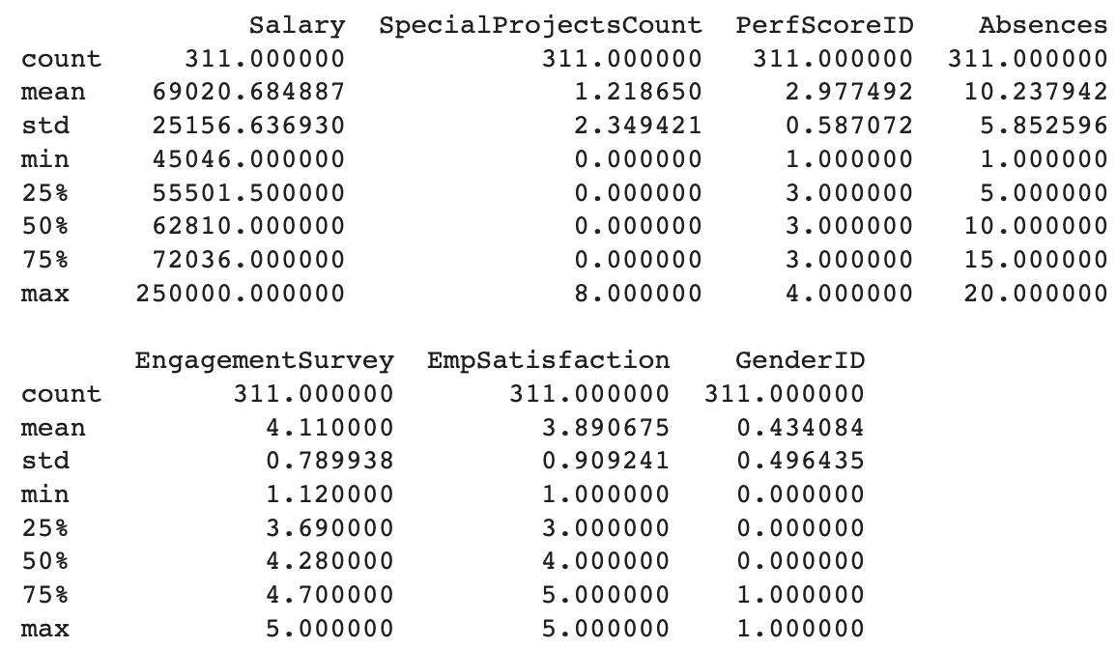
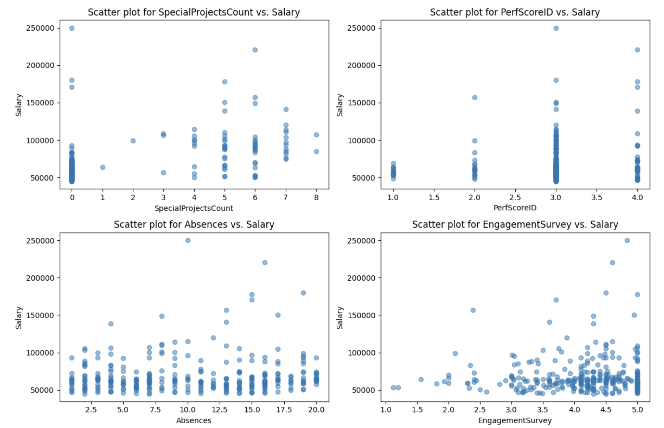
DESCRIPTIVE STATISTICS OF DATASET
Salary: Average salary is $69,020 with variations.
Special Projects: Employees involved in 1.22 projects on average.
Performance Score: Predominantly scored 3 with minimal variation.
Absences: Average of 10.24 absences per year.
Engagement Survey: Average score is 4.11 with some diversity.
Employee Satisfaction: Average rating is 3.89 with variability.
Gender ID: Slightly more employees identified as 0 (56.59%).

Slide 4
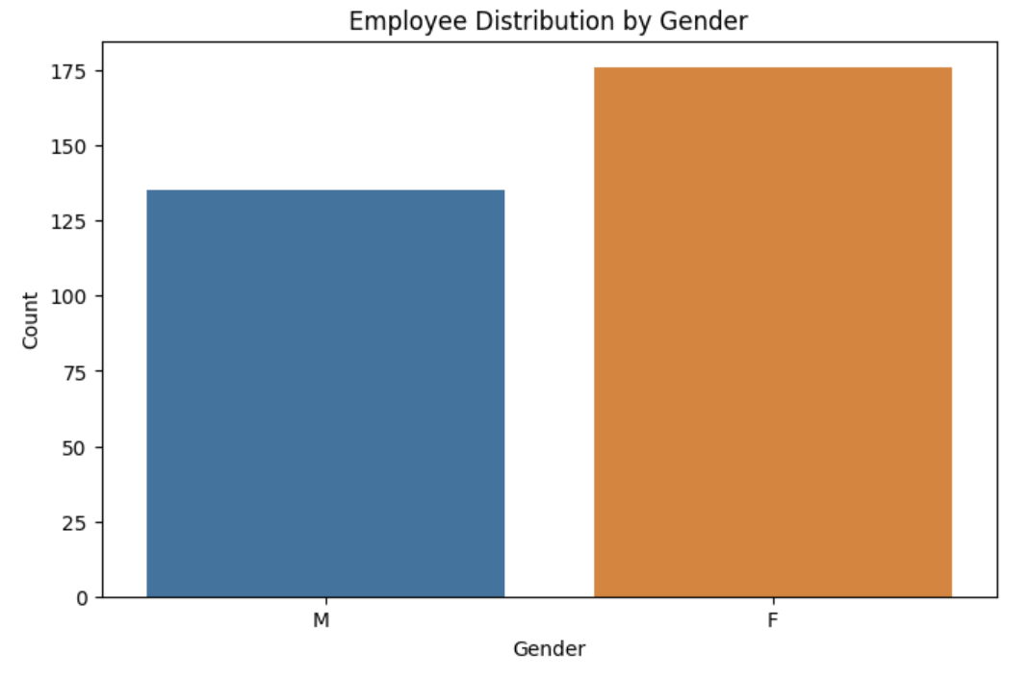
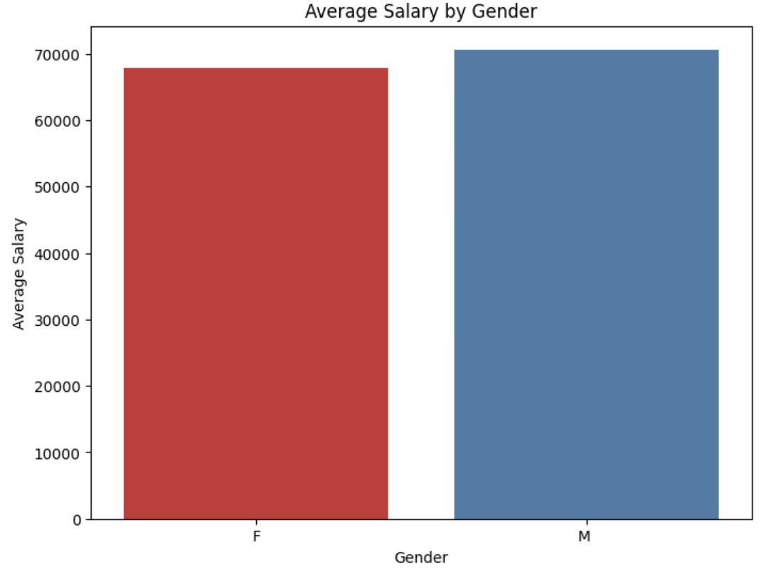
Employee analysis
Gender Diversity & Inclusivity in the Dataset
Gender
Dataset contains 130 male and 175 female employees.
Male employees' average salary: $70,629
Female employees' average salary: $67,78
Emphasizes the importance of gender diversity and inclusivity.
Guides HR practices for creating an equitable workplace.
The gender-based salary gap exists within the organization.
This gap may indicate a potential issue with pay equity and fairness.
Further examination and action are necessary to address and rectify this disparity.
Promoting gender pay equality is not only an ethical obligation but can also positively impact employee satisfaction and workplace diversity..

Slide 5
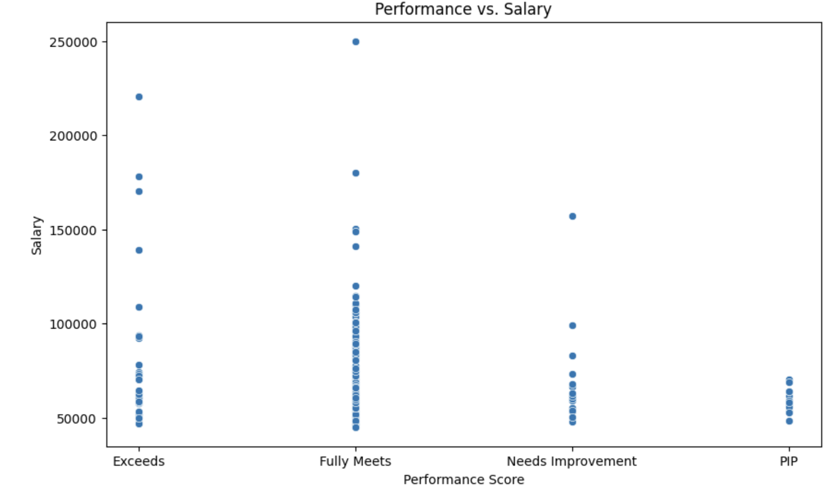
Analyzing the Impact of Performance on Employee Salaries
Fully Meets employees earn $250,000.
"Exceeds Expectations" average $225,000.
"Needs Improvement" at $150,000.
"Performance Improvement Plan" employees earn $52,500.
Key Insights:
Strong correlation between performance scores and salaries.
Rewarding top performers.
Addressing performance gaps.
Encouraging performance improvement.
Guiding compensation strategies.

Slide 6
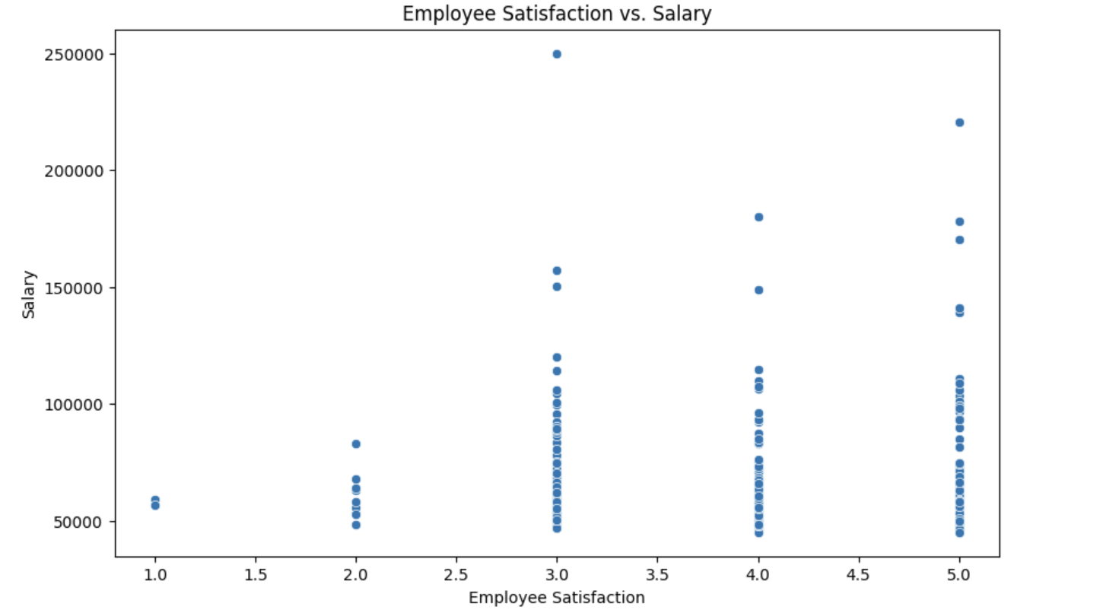
Payroll Insights:
Linking Employee Satisfaction & Salaries
Absences: Average absence days per employee: Approximately 10.24
Majority of employees have between 5 and 15 absences. a relatively stable
Attendance pattern among employees.
Salary: Average salary: Approximately $69,020.68
Significant salary range from $45,046 to $250,000.
This Implies a wide disparity in compensation within the organization.
How Absences Affect Salaries:
Higher absenteeism may contribute to reduced salaries, affecting employee
earning potential and career progression.
Key Insights:
Employee attendance appears consistent, majority taking an average of 10absences.
Salary distribution shows disparities with high variations, ranging from $45,046 to $250,000.
Addressing salary equity and employee attendance policies may be valuable for HR and management.

Slide 7
Unique Termination Reasons
N/A-Still Employed: The majority of employees (207) are still employed, indicating a stable workforce
Another Position: 20 employees left to pursue other job opportunities, potentially within the organization
Unhappy: 14 employees left due to unhappiness with their roles or workplace environment.
More Money: 11 employees sought new employment for better compensation.
Career Change: 9 employees left to pursue different career paths or industries.
Hours: 8 employees departed due to issues related to working hours or schedules.
Attendance: 7 employees left, potentially due to attendance-related problems.
Return to School: 5 employees left to pursue further education.
Relocation Out of Area: 5 employees relocated to different geographical areas.
No-Call, No-Show: 4 employees left without proper notification or communication.
Military: 4 employees joined or returned to military service.
Retiring: 4 employees retired from their jobs.
Performance: 4 employees left due to performance-related issues.

Slide 8
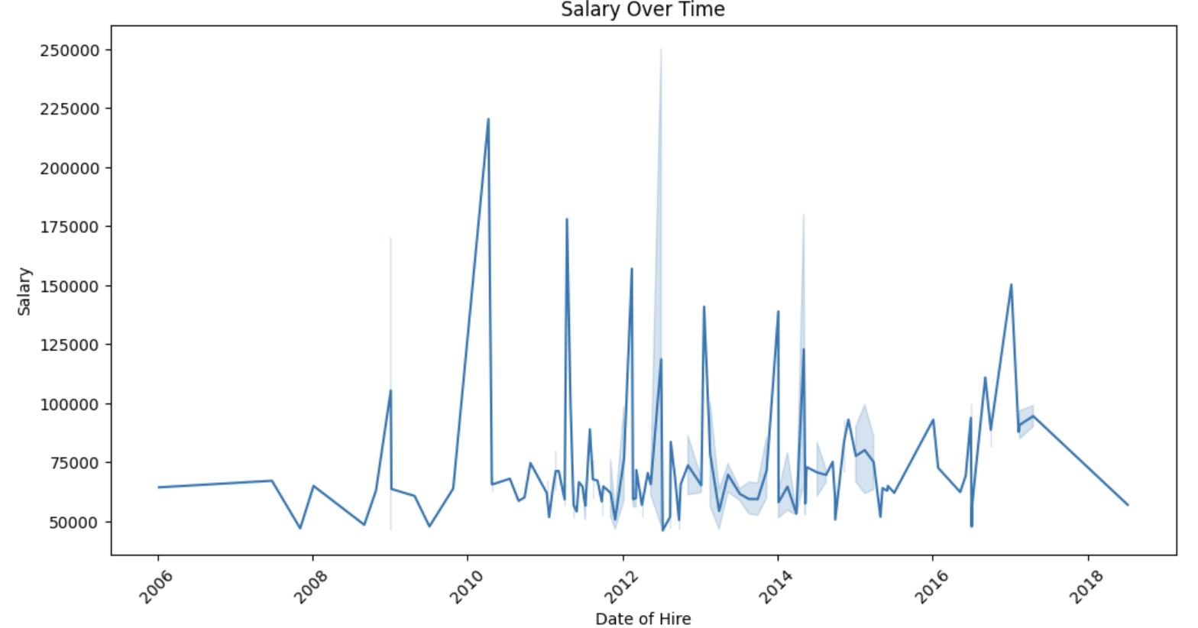
Analysis of Salary Over Time
In this analysis, we explored the relationship between the date of hire and the corresponding
salary for employees. We observed a clear pattern of salary progression over the years
with the following key insights:
Employees hired in 2006 had an initial salary of $50,000.
Salaries increased gradually over time, with employees hired in 2008 receiving $75,000, and
those hired in 2010 earning $100,000.
The trend continued with employees hired in subsequent years, salaries reaching $125,000
for 2012 hires, $150,000 for 2014 hires, $175,000 for 2016 hires, and $200,000 for 2018 hires
The highest recorded salary, $250,000, was for employees hired in 2020.

Slide 9
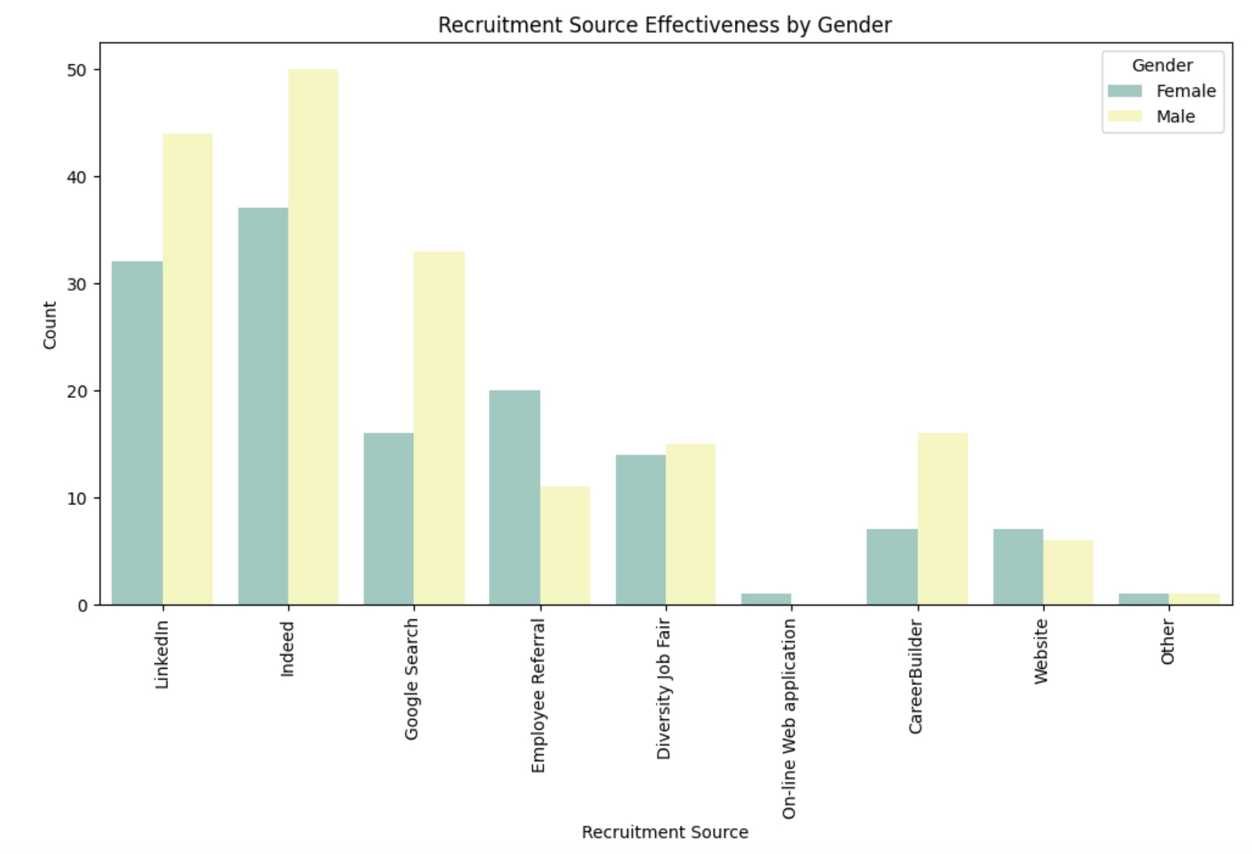
Diversity in Hiring:
Evaluating Source Distribution by Gender
Top recruitment source for females: "Indeed" (50 hires)
Top recruitment source for males: "Indeed" (37 hires)
Close second for females: "LinkedIn" (44 hires)
Close second for males: "LinkedIn" (32 hires)
"Google Search" and "Employee Referral" more prominent for females
"Employee Referral" more significant for males
Insights reveal potential gender-specific recruitment source effectiveness

Slide 10
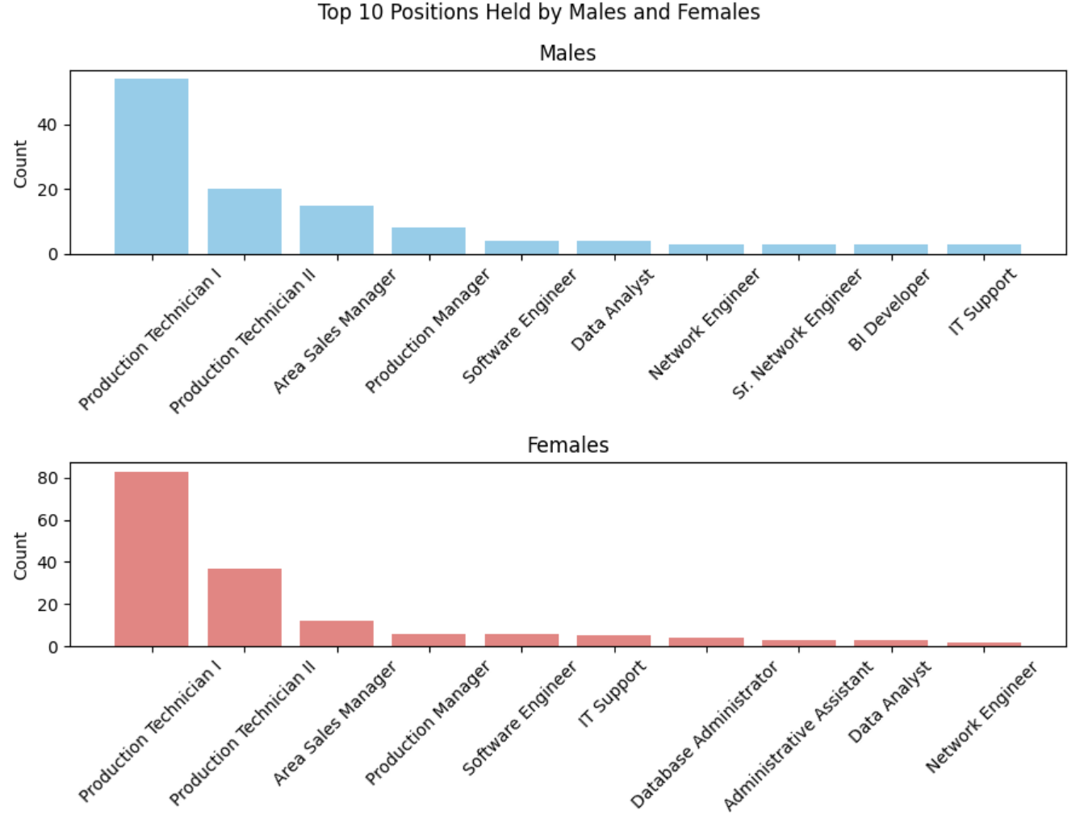
Workplace Diversity: Gender-Based Job Analysis
"Production Technician I" and "Production Technician II" are the most common roles for
both males and females, suggesting roles that do not exhibit significant gender disparities
Males tend to hold the "Area Sales Manager" position more frequently than females.
This could indicate a specific trend in managerial roles.
Roles like "IT Support" and "Database Administrator" are more commonly held by females,
showcasing gender distribution variations in technical positions.
The presence of these distinctions may suggest the need for targeted recruitment
strategies to encourage diversity in job roles.
By recognizing these disparities, organizations can adapt their hiring and promotion practices
to foster a more balanced representation of genders across different job positions.

Slide 11
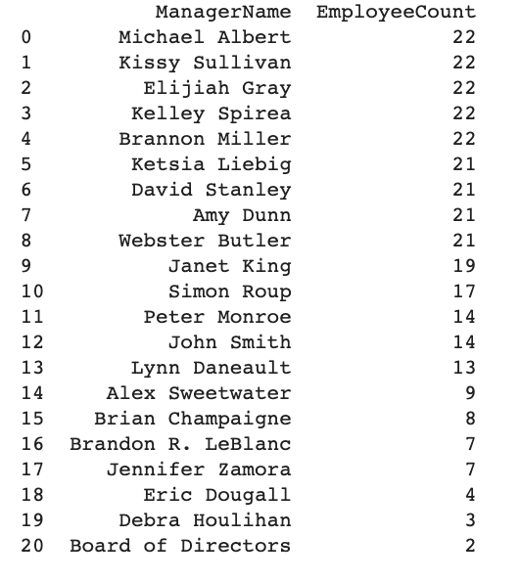
Variability in Managerial Workloads and Employee Distribution
High Variability in Managerial Workload: Varying employee numbers per manager imply
differing levels of responsibility and workload
Balancing Workloads: Managers with larger teams, like Simon Roup, may face challenges in
managing their duties, impacting their well-being.
Optimizing Managerial Resources: Effective resource allocation aligns team size with tasks,
enhancing efficiency and employee satisfaction.
Top Employee Satisfaction: A Rating of 5"
The selected top employees have achieved the highest employee satisfaction rating,
indicating their strong commitment and job satisfaction.
"Low Absenteeism: High Reliability"
These top employees exhibit low absenteeism, often with only 1 or 2 recorded absences,
highlighting their commitment and reliability in attendance.

Slide 12
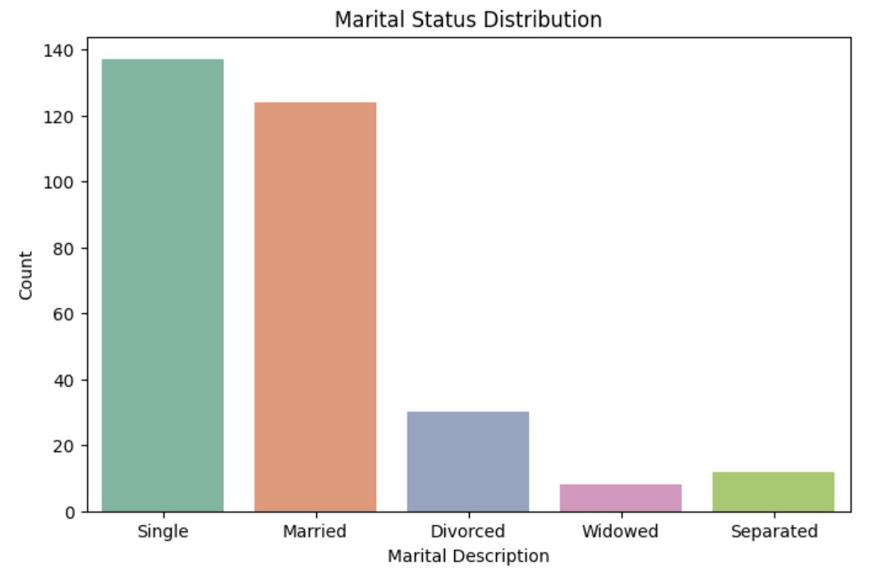
Diverse Employee Marital Status
The organization's employee population is diverse in terms of marital status, with
"Single" and "Married" individuals comprising the majority.
This diversity in marital status highlights the importance of tailoring benefits and support
programs to address the unique needs of employees in various marital status categories.
The presence of "Divorced" and "Widowed" employees demonstrates the need for sensitivity
and flexibility in HR policies and support mechanisms, as these individuals may have needs.
Understanding the distribution of marital status can guide HR in offering family-oriented
benefits and programs for married employees, while also providing targeted
assistance to single employees, who might have different requirements.

Slide 13
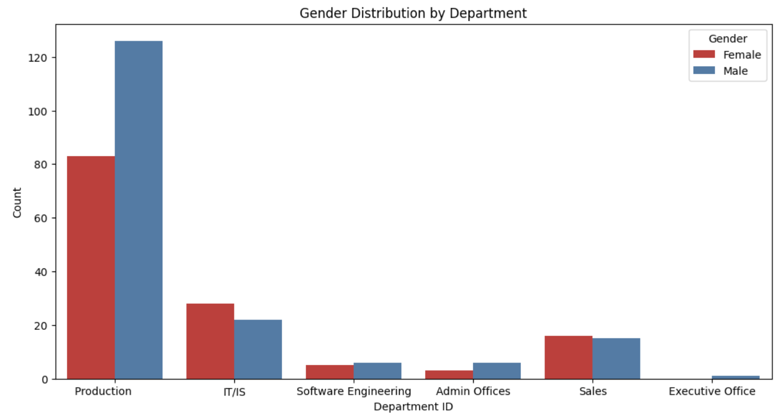
ANALYSING DEPARTMENT
PERFORMANCE
Production Department: The largest department with 209 employees.
T/IS Department: The second-largest department with 50 employees.
Sales Department: Comprising 31 employees.
Software Engineering Department: Houses 11 employees.
Admin Offices: Staffed by 9 employees.
Executive Office: The smallest department with only 1 individual.
This understanding is crucial for informed resource allocation and
efficient departmental management.

Slide 14
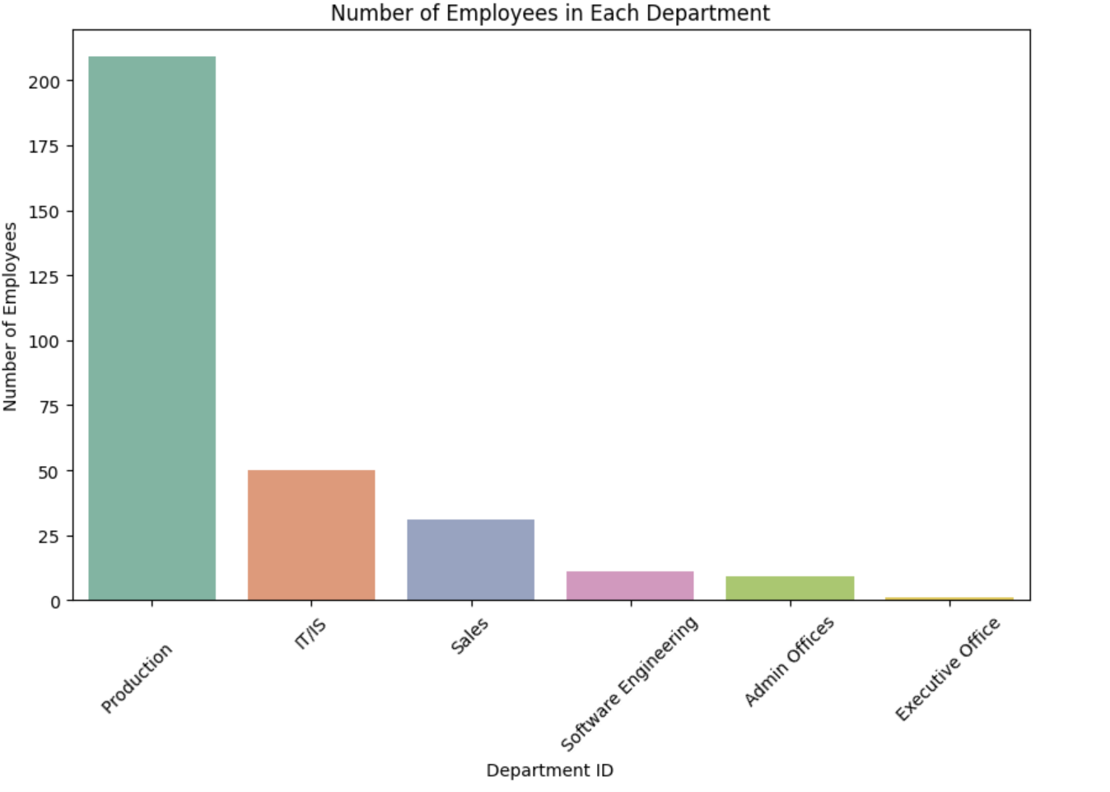
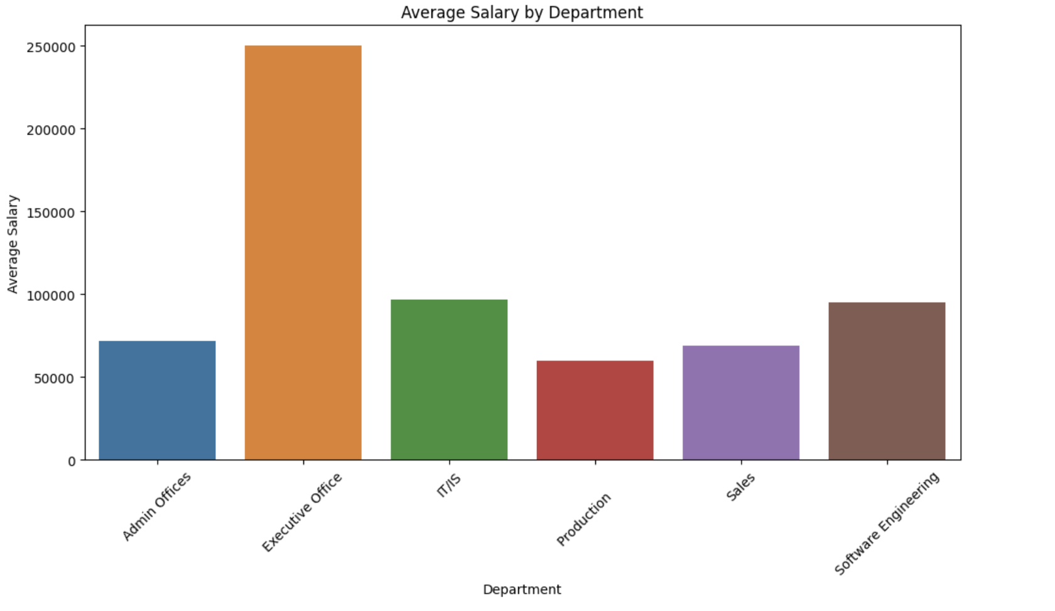
Department Employee Distribution
and Salary Summary
Admin Offices: 9 employees with an average salary of $71,791.89.
Executive Office: 1 employee with a salary of $250,000.
T/IS: 50 employees with an average salary of $97,064.64.
Production: 209 employees with an average salary of $59,953.55.
Sales: 31 employees with an average salary of $69,061.26.
Software Engineering: 11 employees with an average salary of $94,989.45.
This data indicates that salary distributions vary significantly across different departments.
Such insights are crucial for optimizing departmental financial management, ensuring equitable
compensation, and aligning workforce allocation with organizational goals.

Slide 15
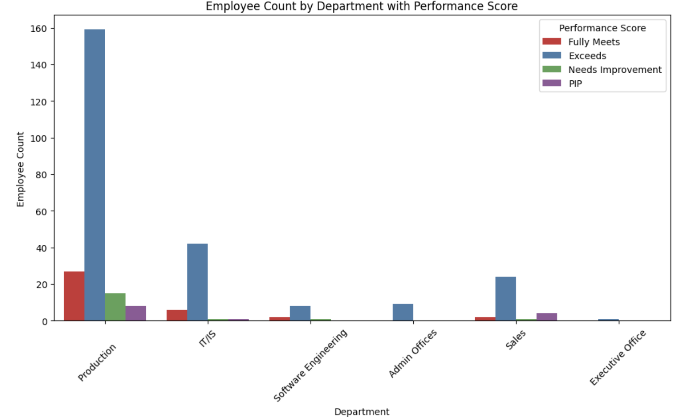
Performance Distribution
Across Departments
Performance Distribution: Visualize performance scores across departments for an overall
understanding of employee performance.
"Fully Meets" Dominance: "Fully Meets" is the most common score, indicating that significant
portion of employees consistently meet performance expectations.
Variations in Performance: While "Fully Meets" dominates, variances exist; some departments
have more employees "Exceeding" expectations, while others require improvement.
Performance Improvement Plans (PIPs): A few employees in specific departments are on PIPs,
signifying the need for targeted improvement efforts.
Comparing Departments: Identify high-performing and development-needed departments
through inter-departmental comparisons.

Slide 16
THANK YOU

